Slide 1
HIGH PERFORMANCE GREEN PORT GIURGIU 2012-EU-18089-S The project is in line with the Priority Project no 18 Waterways Axis Rhine-Main-Danube of the TET-T Network

Slide 2
Project partners
ILR Logistica Romania S.R.L. –
www.ilr.com.ro
Industrie-Logistik-Linz GmbH
www.ill.co.at
Giurgiu Free Zone Administration
www.zlg.ro
Giurgiu Municipality
www.primariagiurgiu.ro

Slide 3
Project Financing TEN-T Program
Overal project budget:
800 000 Euro
EU Contribution
400 000 Euro (50%)
Project Partners Contribution
400 000 Euro (50%)

Slide 4
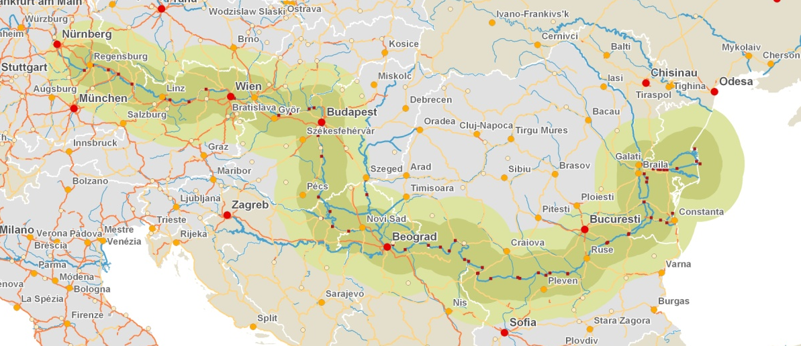
Project Goal: GREEN PORT established in Giurgiu

Slide 5
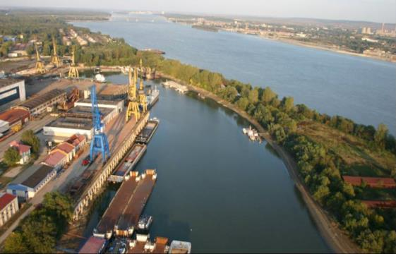
Specific objectives
Giurgiu Port - the first Green Danube Port in Europe
Integrated energy-efficiency concepts
Comprehensive environmental measures for intermodal ports

Slide 6
Project Output
Euro-Regional development
Bucharest-Giurgiu-Rousse
and
high potential for future investments

Slide 7
Main investment Multi - modal Port (water-road-rail) all weather terminal

Slide 8
Green Port Concept
Measures for Energy efficiency - renewable and alternative energy within the port (LNG as fuel for trucks and port equipment)
Revitalization of the existing port area and infrastructure
Port development model for high-performance Green Danube Ports to be disseminated to all Danube ports

Slide 9
Main benefits of the green port concepts
the concept of sustainable development put into practice
reduced overall gas emissions (CO, CO2 and others), noise and dust levels due to the smarter infra- and super-structure
larger cargo volumes transported by inland waterways, instead of roads
increase the port capacity and efficiency
a model for other Danube Ports

Slide 10
First stage results –Technical Studies & Programming Documents
feasibility studies for the future investment project
report on the new green concept of infra and supra-structure
defining the operational concept of green port
port development plan
business plan
strategy for applying the green port concept

Slide 11
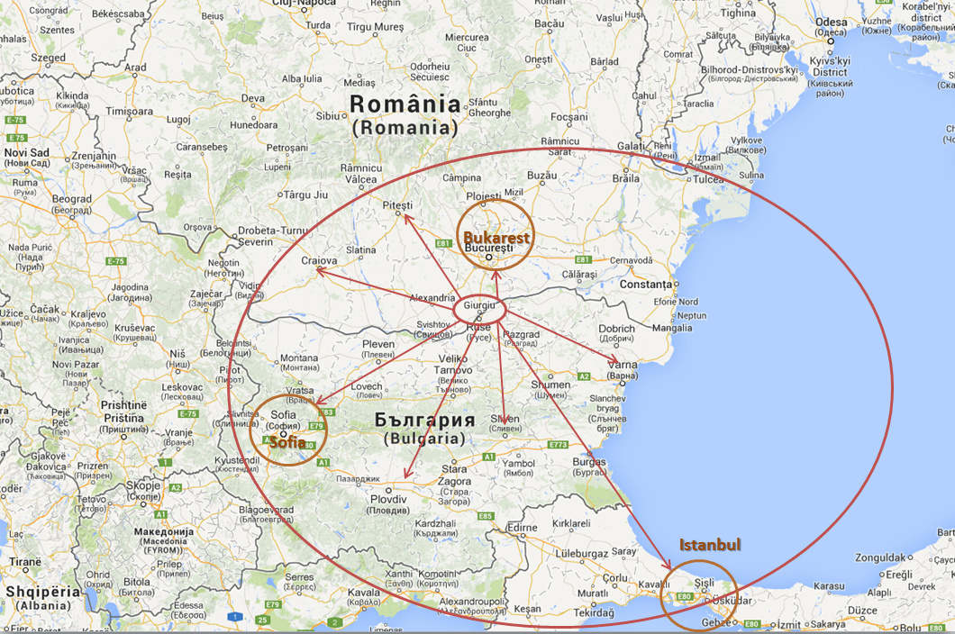
Giurgiu will become a crossing point for the Balkans

Slide 12
Reasons to invest in Romania
Connecting the logistic terminals along the Danube
Transfer of experience and knowledge to Romania
High potential of the Romanian market

Slide 13
NEXT STEP
The investment project submitted for financing under CEF Programme
HIGH PERFORMANCE GREEN PORT
STAGE II - CONSTRUCTION

Slide 14
New project objectives
Modernizing the berth
(the existing quay)
High performance crane
(50 tones)
Railroad extension
Road infrastructure rehabilitation

Slide 15
New project objectives
Dredging the waterways
Modernizing the IT Systems
Integrating the systems with RIS
(River Informatics System )

Slide 16
Next financing: CEF 2014-2020
Project partners:
ILR Logistica Romania S.R.L.
www.ilr.com.ro
Giurgiu Municipality
www.primariagiurgiu.ro
Giurgiu Free Zone Administration
www.zlg.ro

Slide 17
Thank you for your attention For any further information do not hesitate to contact us: Nicolae BARBU MAYOR GIURGIU MUNICIPALITY primar@primariagiurgiu.ro primarie@primariagiurgiu.ro

